Slide 1
CSE 3002- programming in java unit III collections, streams, filters
Dr. R. Manikandan
Assistant professor (senior grade)
Vit bhopal university

Slide 2
Builder Design Pattern
The builder pattern is a creational design pattern used to assemble complex objects. With the builder pattern, the same object construction process can be used to create different objects.
Builder pattern aims to “Separate the construction of a complex object from its representation so that the same construction process can create different representations.”
It is used to construct a complex object step by step and the final step will return the object.
The process of constructing an object should be generic so that it can be used to create different representations of the same object.

Slide 3
Builder Design Pattern
The builder has 4 main parts: a Builder, Concrete Builders, a Director, and a Product.
A Builder is an interface (or abstract class) that is implemented (or extended) by Concrete Builders. The Builder interface sets forth the actions (methods) involved in assembling a Product object. It also has a method for retrieving the Product object (ie, getProduct()).
The Product object is the object that gets assembled in the builder pattern.
Concrete Builders implement the Builder interface (or extend the Builder abstract class). A Concrete Builder is responsible for creating and assembling a Product object. Different Concrete Builders create and assemble Product objects differently.
A Director object is responsible for constructing a Product. It does this via the Builder interface to a Concrete Builder. It constructs a Product via the various Builder methods.

Slide 4
Builder Design Pattern
Example: To build different kinds of restaurant meals.
Product: Meal
Product will be a Meal class, which represents food items in a meal. It represents a drink, main course, and side item. (Meal.java)
Builder interface: MealBuilder.
It features methods used to build a meal and a method to retrieve the meal. (MealBuilder.java)
Concrete Builder
ItalianMealBuilder: Its constructor creates a meal. Its methods are implemented to build the various parts of the Italian meal. It returns the meal via getMeal(). (ItalianMealBuilder.java)
JapaneseMealBuilder: Its constructor creates a meal. Its methods are implemented to build the various parts of a Japanese meal. It returns the meal via getMeal(). (JapaneseMealBuilder.java)

Slide 5
Builder Design Pattern
Example: To build different kinds of restaurant meals.
Director (MealDirector.java)
It takes a MealBuilder as a parameter in its constructor.
Thus, a different type of meal will be assembled by the MealDirector depending on the Concrete Builder passed in to the constructor.
The assembly of the meal (Product) takes place in the constructMeal() method of the Director. This method spells out the parts of the meal that will be assembled.
BuilderPatternDemo.java
First, our director builds an Italian meal. An ItalianMealBuilder is passed to the MealDirector's constructor. The meal is constructed via mealDirector.constructMeal(). The meal is obtained from mealDirector via mealDirector.getMeal(). The Italian meal is displayed. After this, we perform the same process to build and display a Japanese meal.

Slide 6
Builder Design Pattern
Usage
if we'd like the construction process to remain the same but we'd like to create a different type of Product, we can create a new Concrete Builder and pass this to the same Director.
If we'd like to alter the construction process, we can modify the Director to use a different construction process.
The parameters to the constructor are reduced and are provided in highly readable method calls.

Slide 7
Stream API
A stream is a sequence of objects that supports various methods which can be pipelined to produce the desired result. To perform a computation, stream operations are composed into a stream pipeline.
A stream pipeline consists of a source, zero or more intermediate operations (which transform a stream into another stream), and a terminal operation that ends the use of a stream.
A stream pipeline consists of:
A source: An array, a collection, a generator function, an I/O channel
Zero or more intermediate operations, which transform a stream into another stream filter(Predicate)
A terminal operation, which produces a result or side effect count() or forEach(Consumer)

Slide 8
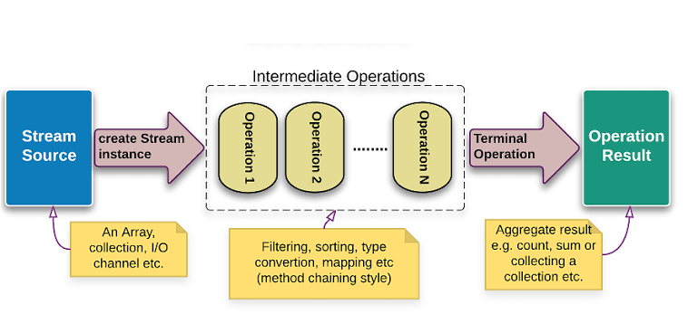
Stream API

Slide 9
Stream API
A stream pipeline consists of a source, zero or more intermediate operations (which transform a stream into another stream), and a terminal operation that ends the use of a stream.
To perform a computation, stream operations are composed into a stream pipeline.
A stream pipeline consists of:
A source: An array, a collection, a generator function, an I/O channel
Zero or more intermediate operations, which transform a stream into another stream filter(Predicate)
A terminal operation, which produces a result or side effect count() or forEach(Consumer)
Streams may be lazy. Computation on the source data is performed only when the terminal operation is initiated, and source elements are consumed only as needed.
Classes: DoubleStream, IntStream, LongStream

Slide 10
Stream API: Operations
Intermediate Operations:
map: The map method is typically used to extract data from a field and perform a calculation or operation. The results of the mapping operation are returned as a stream.
Syntax: map(Function<? super T,? extends R> mapper)
A Function takes one generic and returns something else.
Primitive versions of map
mapToInt() mapToLong() mapToDouble()
filter: The filter method is used to select elements as per the Predicate passed as argument.
Syntax: Stream<T> filter(Predicate<? super T> predicate)
predicate: It takes Predicate reference as an argument. Predicate is a functional interface. So, you can also pass lambda expression here.

Slide 11
Stream API: Operations
Intermediate Operations:
sorted: The sorted method can be used to sort stream elements based on their natural order.
Syntax: sorted(Comparator<? super T> comparator)
Returns a stream consisting of the elements sorted according to the Comparator

Slide 12
Stream API: Operations
Terminal Operations:
collect: The collect method allows you to save the results of all the filtering, mapping, and sorting that takes place in a pipeline.
It takes a Collectors class as a parameter. The Collectors class provides a number of ways to return the elements left in a pipeline.
Syntax: collect(Collector<? super T,A,R> collector)
Examples
stream().collect(Collectors.toList());
stream().collect(Collectors.toMap());
forEach: The forEach method is used to iterate through every element of the stream.
reduce: The reduce method is used to reduce the elements of a stream to a single value. The reduce method takes a BinaryOperator as a parameter.

Slide 13
Search Methods
findFirst()
Returns the first element that meets the specified criteria
allMatch()
Returns true if all the elements meet the criteria
noneMatch()
Returns true if none of the elements meet the criteria
All of the above are short-circuit terminal operations.
findAny()
Returns the first element found that meets the specified criteria
Results may vary when performed in parallel.
anyMatch()
Returns true if any elements meet the criteria
Results may vary when performed in parallel.
Notes:
The findFirst method of the Stream class finds the first element in the stream specified by the filters in the pipeline. The findFirst method is a terminal short-circuit operation. This means intermediate operations are performed in a lazy manner, resulting in more efficient processing of the data in the stream. A terminal operation ends the processing of a pipeline.
The allMatch method returns whether all elements of this stream match the provided predicate. The method may not evaluate the predicate on all elements if not necessary for determining the result. If the stream is empty, true is returned and the predicate is not evaluated.
The noneMatch method returns whether no elements of this stream match the provided predicate. May not evaluate the predicate on all elements if not necessary for determining the result. If the stream is empty, true is returned and the predicate is not evaluated.

Slide 14
Stream Data Methods
count() : Returns the count of elements in this stream
max(Comparator<? super T> comparator)
Returns the maximum element of this stream according to the provided Comparator
min(Comparator<? super T> comparator)
Returns the minimum element of this stream according to the provided Comparator
average() :
Returns an optional describing the arithmetic mean of elements of this stream
Type returned depends on primitive class.
sum() : Returns the sum of elements in this stream
Methods are found in primitive streams:
DoubleStream, IntStream, LongStream
Notes:
The count method returns the number of elements in the current stream. This is a terminal operation.
The max method returns the highest matching value given a Comparator to rank elements. The max method is a terminal operation.
The min method returns the lowest matching value given a Comparator to rank elements. The min method is a terminal operation.

Slide 15
Examples
Stream1.java (Basics)
Stream2.java (Iteration)
Stream3.java (Filter based on more than one condition)
Stream4.java (Iterate the filtered element using forEach)
Stream5.java (Reduce)
Stream6.java (Min & Max)
Stream7.java (Method Reference)
Stream8.java (findFirst & findAny)
Notes:
The count method returns the number of elements in the current stream. This is a terminal operation.
The max method returns the highest matching value given a Comparator to rank elements. The max method is a terminal operation.
The min method returns the lowest matching value given a Comparator to rank elements. The min method is a terminal operation.

